Slide 1

Architecture Breakdown of a Fine-Tuned BERT Model for Sentiment Analysis
Presented By:
Zach Johnson

Slide 2
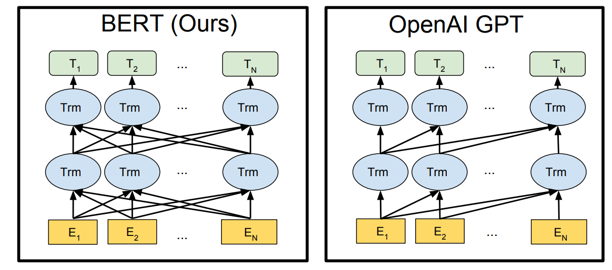
BERT-Tiny
BERT – Bidirectional Encoder Representations from Transformers
Discriminative model (Natural Language Understanding)
Bidirectional Contextualization: considers context of words before and after each word
Built on Transformer Architecture (self-attention)
Contextual understanding makes BERT perfect for Sentiment Analysis
BERT-Tiny
4.3 Million Parameters
2 Transformer Layers

Slide 3

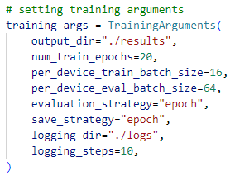
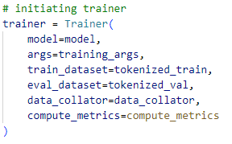

Fine-Tuning for Sentiment Analysis
Dataset: IMDB Large Movie Review Dataset from HuggingFace
50,000 highly polar movie reviews labeled positive or negative
Each movie review is tokenized:
HuggingFace Transformers: TrainingArguments and Trainer
Train!

Slide 4

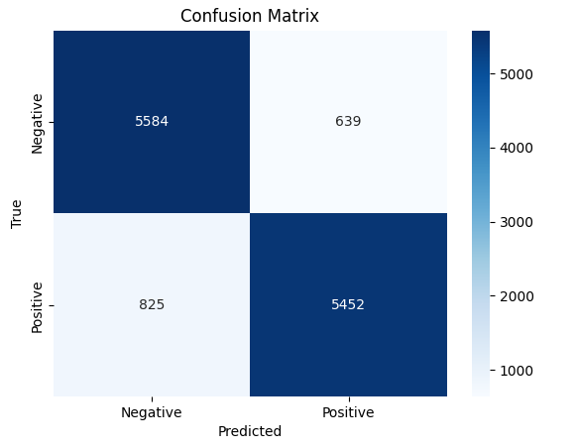
Model Performance
88% accuracy on very small BERT model (BERT-Tiny)
Higher precision (0.895) means positive predictions are usually correct
Lower recall (0.868) indicates more positive reviews are missed
The model is more conservative when predicting positive
Positive reviews that are ambiguous will likely be misclassified as negative
F1 score indicates strong and balanced performance with:
Identifying positive sentiment
Minimizing missed positives

Slide 5
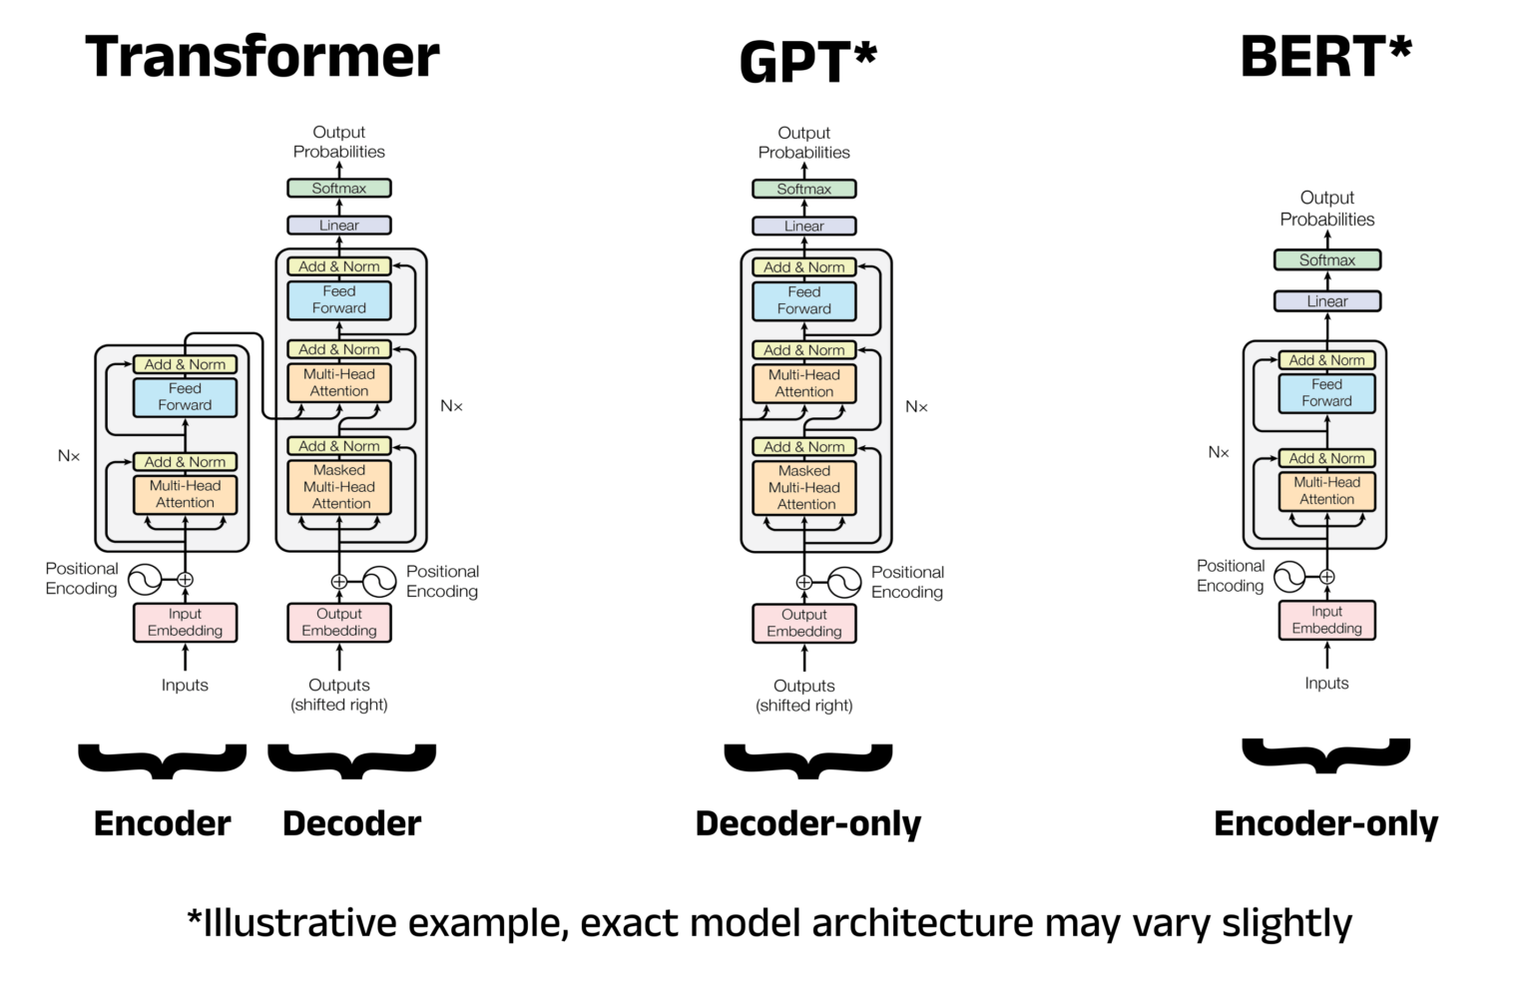

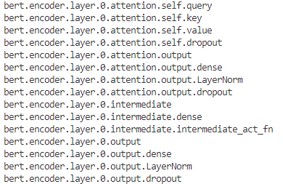

BERT Architecture
BERT uses an Encoder-only Transformer Architecture
Specifically for BERT-Tiny:
Input Embedding Layer
Two Transformer Layers
Classification Head
Fine-Tuned Weights and Biases for each layer can be accessed through HuggingFace Transformer Model:
Goal is to design model entirely from scratch using only matrix multiplication!

Slide 6
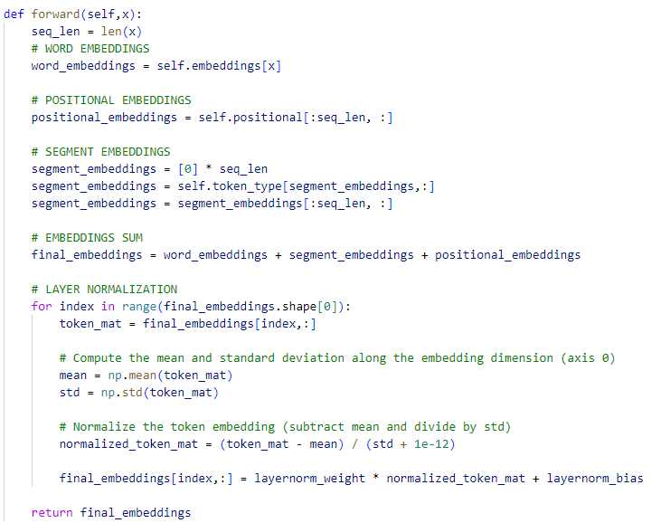
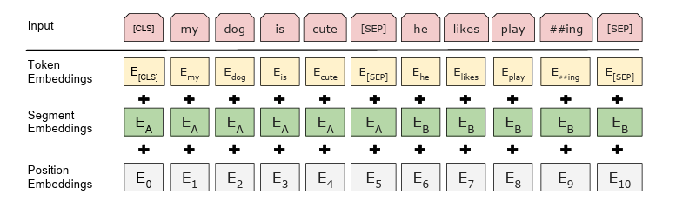
Embedding Layer
Converts input text to vector representations that the model can understand
Considers three embeddings:
Token Embeddings (unique vector for every token in vocabulary)
Segment Embeddings (separates multiple sentences for applications like question/answering)
Position Embeddings (indicates to the model the position of each token in the sequence)
Each embedding is summed together and normalized

Slide 7
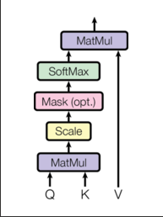
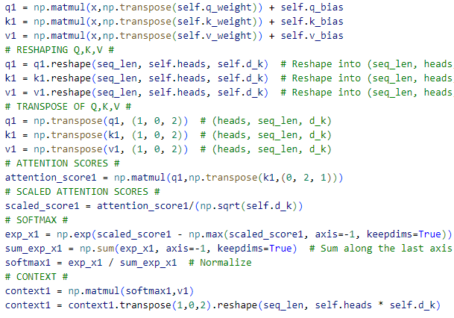
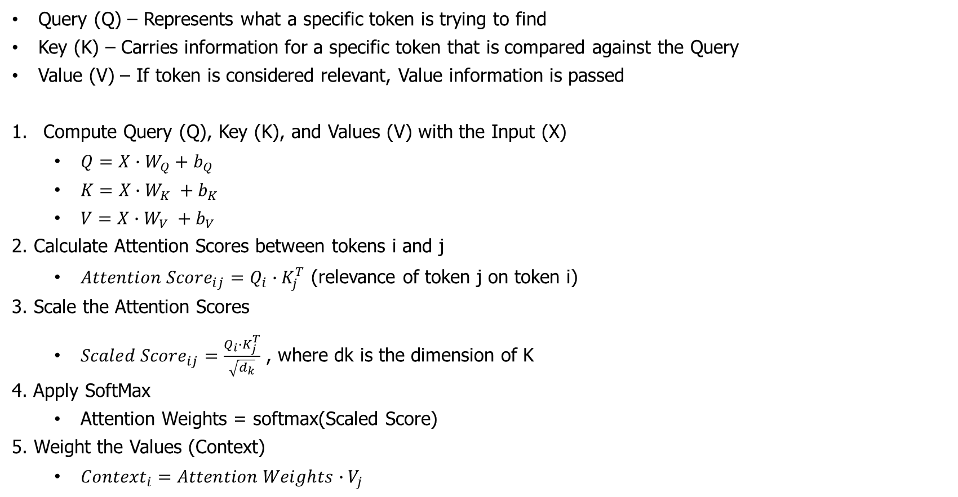
Transformer Layer: Self-Attention
Query (Q) – Represents what a specific token is trying to find
Key (K) – Carries information for a specific token that is compared against the Query
Value (V) – If token is considered relevant, Value information is passed
Compute Query (Q), Key (K), and Values (V) with the Input (X)
$Q=X∙W_{Q}+b_{Q}$
$K=X∙W_{K} +b_{K}$
$V=X∙W_{V} +b_{V}$
2. Calculate Attention Scores between tokens i and j
${Attention Score}_{ij}=Q_{i}∙K_{j}^{T}$ (relevance of token j on token i)
3. Scale the Attention Scores
${Scaled Score}_{ij}=\frac{Q_{i}∙K_{j}^{T}}{\sqrt{d_{k}}}$ , where dk is the dimension of K
4. Apply SoftMax
Attention Weights = softmax(Scaled Score)
5. Weight the Values (Context)
${Context}_{i}=Attention Weights∙V_{j}$

Slide 8

Transformer Layer: Feed-Forward Network
Feed-Forward Network processes calculated attention and models more complicated patterns for each token
FFN consists of:
Intermediate Dense Layer
GELU activation function
Gaussian Error Linear Unit – smoothly pushes toward 0 for small/negative inputs and makes output close to linear for positive inputs. (not hard-cutting like poslin/ReLU)
Nonlinearizes attention input that is inherently linear, allowing for more sophisticated decision boundaries
Output Dense Layer

Slide 9
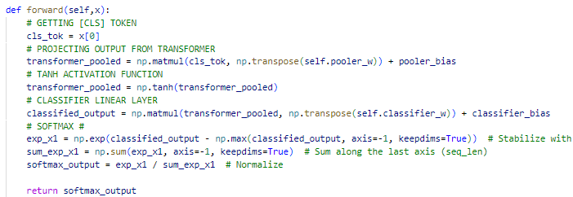
Classification Head
Consists of:
Pooler
Summarizes entire sequence into [CLS] token
Tanh activation function
Puts output from pooler in range [-1, 1]
Classifier Dense Layer
Outputs unnormalized scores for each class (2)
Softmax
Puts output in terms of probability each class is correct

Slide 10

Why?
We now have BERT-Tiny designed entirely using only Matrix Multiplication/Addition using fine-tuned weights and biases.
BERT-Tiny is very small – only around 4.3 million parameters
Assuming each parameter is stored as FP32 (32-bit floating point)
This means around 16.4 MB of memory is required to store all parameters
Can be reduced even further with quantization
Enables a lightweight, application-specific language model for efficient digital IC deployment!

